Slide 1



BENEFITS OF GOING TO COLLEGE
THE COLLEGE BOUND COMMITMENT - 2024-25

Slide 2

WHO DO YOU KNOW THAT WENT TO COLLEGE?
Notes:
Helpful tips:
- You can have your audience share their answers to this question
- You can share your experience about who the first person you met/learned about who went to college was
- If you are a first-generation college graduate, share that experience

Slide 3
WHY SHOULD I GO TO COLLEGE?
More school = More $$$
Getting a college degree = More jobs to choose from
A MAJORITY of jobs in Washington will require some college
It’s FUN and you get to meet new people from all over

Slide 4




AVERAGE INCOME BY EDUCATION LEVEL
MORE SCHOOL MEANS
MORE MONEY
$36,816
$46,748
$55,016
$77,636
Less than high school
High School Diploma
Associate’s Degree
Bachelor’s degree
Notes:
Young adults with an associate’s degree earn an average of $10,000 more per year than those with just a high school diploma.
How much is that in real terms? What could you buy with $10,000?
Ask students to volunteer more names of jobs. Match those jobs to the education level and average salary bracket.
Talk about the range of salaries made in jobs that require an Associate’s Degree
Average Income by Education Level taken from the Bureau of Labor of Statistics, 2023.
(https://www.bls.gov/careeroutlook/2024/data-on-display/education-pays.htm)

Slide 5
WHAT TYPES OF COLLEGES ARE THERE?
Community and Technical Colleges (CTCs)
Schools that offer associate’s degrees, apprenticeships, and certificates including specific trades
Private 2-Year Vocational /Trade College
Schools provide education for a specific career.
Public and Private 4-Year College
Schools offer bachelor’s degrees, usually completed in 4 years of full-time study.

Slide 6
APPRENTICESHIP JOBS
Aircraft Mechanic
Automotive Mechanic
Brick layer
Carpenter
Electrician
Fire Fighter
Truck Driver
Welder
Pipe Fitter
Cement Mason
Flagger
Painters
MORE SCHOOL MEANS
MORE JOB OPTIONS
ASSOCIATE DEGREE JOBS
Culinary arts
Paralegal
Dental hygiene
Cosmetology
Physical Therapist
Radiologic Tech
Electrical Drafter
Electronic Engineer
Computer Support
Web Developer
Registered nurse
Cybersecurity
BACHELOR DEGREE JOBS
Editor
Foreign Services Officer
Market Researcher
Social Worker
Marketing Exec
Writer
Community Organizer
Teacher
Marine Biologist
Chemical Engineer
App Developer

Slide 7
HOW DO I PAY FOR COLLEGE?
MYTH: I can’t go to college because it’s too expensive.
FACT: Financial Aid can help you pay for college. Financial Aid resources include any scholarship, grant, work study or loan offered to help meet your college expenses.

Slide 8
TYPES OF FINANCIAL AID
1
SCHOLARSHIPS: Money awarded based on academic or other achievement.
2
GRANTS: A form of gift aid, usually based on financial need.
WAYS TO PAY FOR COLLEGE
3
WORK STUDY: A program that allows students to work on or off-campus to earn money.
4
LOANS: Money you borrow and repay over time, with interest added in most cases.

Slide 9
WHAT IS
COLLEGE BOUND (CB)?
Early commitment of state financial aid to eligible 7th and 8th and some 9th grade students to help pay for your education after high school.
Combines with other state financial aid, like the Washington College Grant, to cover the average cost of tuition (at public college rates), some fees, and a small amount for books = commitment of funds.
Not sure if you’re enrolled? Check with your counselor!
Notes:
Are you interested in health care? Construction? Video game design? Running a business? Whatever your career goals, College Bound can help you attend and pay for the school that is right for you!
College Bound is an early commitment of state financial aid that works in combination with other state aid, like the Washington College Grant, to help pay for eligible students’ education after high school. The amount of money you receive is based on average tuition (at public college rates), some fees, and a small amount for books. You can use College Bound to help pay for your education at over 65 participating colleges, universities, and technical schools in Washington.
Most College Bound eligible students receive their commitment of state financial aid assistance through the Washington College Grant. This is known as the College Bound and Washington College Grant Coordination.

Slide 10

ENROLLING IS A TWO-STEP PROCESS…
1.
WHO
CAN GET
COLLEGE
BOUND?
STEP
Be eligible for free and reduced-price lunch (FRPL) in 7th, 8th, or newly eligible in 9th grade (Youth in foster care are eligible through high school graduation).
Eligible public school students are automatically enrolled.*
2.
Fulfill the College Bound Pledge.
STEP
Complete either the FAFSA or WASFA and meet income requirements; verified by the college.
Be accepted to and attend an eligible college or career training within one academic year of high school graduation to receive CB funds.
Notes:
In order to receive College Bound, you had to complete an application, or you were automatically enrolled in middle school. If you have questions about whether you have a complete College Bound application contact your counselor or Washington Student Achievement Council at collegebound@wsac.wa.gov.
Please note: The class of 2026 is the first completely auto-enrolled class.
Additional Info for Presenters:
The requirements for newly eligible 9th graders are:
Enrolled in a Washington school in 7th or 8th grade. (public, private, or homeschooled)
Not eligible for FRPL in 7th or 8th grade.
Newly eligible for FRPL in 9th grade.
Added the asterisks for our eligible homeschooled and private school students. College Bound program staff can assist families with starting an application.
Note: Several school districts may have a type of homeschool/parent partnership program where a homeschooled student can be automatically enrolled. Families can confirm a student's enrollment prior to starting an application by contacting the College Bound program. Collegebound@wsac.wa.gov or 888.535.0747, option 1.
Step 1: Based on USDA Income Guidelines, changes yearly (Income eligibility to Sign Up for CB)
Step 2: Based on the Median Family Income (MFI) Chart, changes yearly (Income Eligibility to Receive CB)
(These are two separate income eligibility charts – one to sign up and one to receive; there is confusion around this and we want to clear it up)
An important distinction is that the financial aid office of the college will determine College Bound eligibility based on the financial aid application. This will change from year to year.

Slide 11

THE COLLEGE BOUND
PLEDGE:
Graduate with a 2.0 GPA or better from a WA high school or approved homeschool program for students attending a four-year school directly after high school
There is NO GPA requirement for students who plan to attend a community college or technical school
Have no felony convictions
Be income eligible (verified with info from the FAFSA or WASFA) and this is updated annually
Enroll in an eligible program within one academic year of high school graduation to meet the college enrollment deadline
Meet the program’s state residency standards
Notes:
We want to make sure that you meet all the requirements so that you are able to receive all your scholarship. In order to remain eligible, you need to complete all of the following pledge requirements.
After being enrolled in middle school, eligible students must fulfill the College Bound requirements:
There is no high school GPA requirement if you who plan to attend a community college or technical school. However, you must graduate from high school.
Graduate from a Washington State high school with a 2.0 GPA or better if you plan to attend a four-year public or private college right after high school.
Have no felony convictions.
Be income eligible, as determined by your college using the information from your FAFSA or WASFA. You can view current income requirements for the CBS by visiting wsac.wa.gov/college-bound#income-eligibility-to-receive-cbs
Get accepted to and go to one of the over 65 participating colleges or universities or programs within one year of graduating high school. Visit wsac.wa.gov/sfa-institutions for a complete list of eligible schools

Slide 12
CB award amounts are based on eligibility and what type of college you go to.
Most of the CB commitment will be funded by the Washington College Grant.
The award amounts are based on:
HOW MUCH WILL I GET?
COLLEGE BOUND COMMITMENT $
AVERAGE COST OF TUITION
(public rates)
A SMALL AMOUNT FOR BOOKS
SOME
COLLEGE
FEES
Notes:
Here you can see what College Bound is based on (not what it covers). Keep in mind that each College Bound award may be different for everyone and in some cases, CB funds can help with other costs if other aid has already covered tuition.
The scholarship is based on the student, the type of college they go to, and their financial need from year to year. While not ALL college costs are covered by College Bound, other financial aid (such as grants (Pell), work-study, loans, and scholarships) may assist in helping you pay for other college expenses such as housing, meals, and transportation.
Most of your CB award amount will actually be from the Washington College Grant.

Slide 13














WHERE
CAN YOU
USE IT?
There are over 65 colleges, universities, and technical schools where you can use College Bound
And more... You can find a list online at www.wsac.wa.gov/sfa-institutions
Notes:
Now that you know that College Bound can help you pay for college, you probably want to know where you can use it. There are over 65 2 and 4-year public and private colleges, universities, and technical programs that accept College Bound in Washington state. This means that you can attend schools like (please replace with schools that are relevant to your region) the University of Washington, Central Washington University, North Seattle Community College, or the Gene Juarez Academy! This means that you have a LOT of choices in Washington and all these colleges will help you start a career that you are interested in and will enjoy.
Please see the list of eligible institutions if you add or delete colleges: https://wsac.wa.gov/sfa-institutions

Slide 14
A:
WHAT’S NEXT?
PREPARE
Be sure you take the right courses for graduation and college admission.
B:
PLAN
Explore different school and job options with your counselor.
C:
FULFILL
Be sure you review the pledge requirements to receive
College Bound
APPLY
Apply in your senior year to eligible colleges and for financial aid with either the FAFSA or WASFA.
Notes:
Refer back to slide 11 for pledge requirements

Slide 15
Must enroll in college within one year of high school graduation.
CB can fund up to 6 years of college enrollment. A Bachelor’s degree is the highest degree you can earn using CB funds.
Maintain “satisfactory academic progress” with the college or program to receive CB funds.
File the FAFSA or WASFA every year - income eligibility is checked each year of college.
NEED TO
KNOW:
THERE ARE
REQUIREMENTS BUT
THERE’S ALSO
FLEXIBILITY!
Notes:
(Bullet 1) Even 1 earned credit meets this requirement. Running start meets the enrollment deadline but does NOT take away from the ability to use the full scholarship amount and time allotment.
(Bullet 2) College Bound students can now receive CB funding for up to 6 years of enrollment or (12 semesters or 18 quarters(, which doesn’t expire IF the student is enrolled in college or career training within one year of HS graduation and meets “other program requirements” each year they are enrolled in college. A Bachelor's degree is the highest degree you can earn using the College Bound funds.
(Bullet 4) If you are not income eligible one year then you may be income eligible the following year.

Slide 16

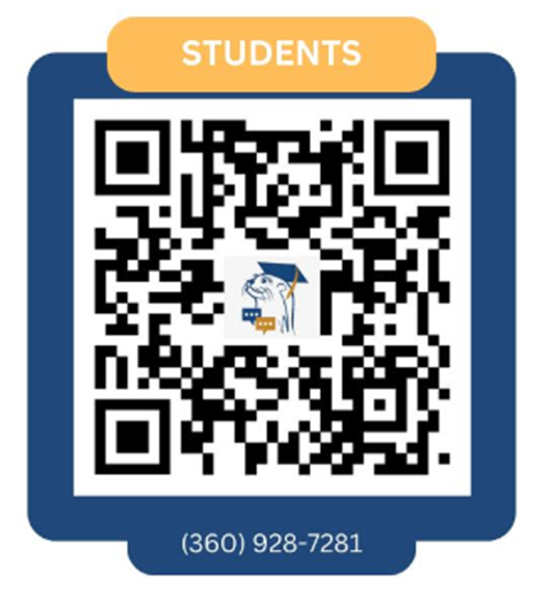
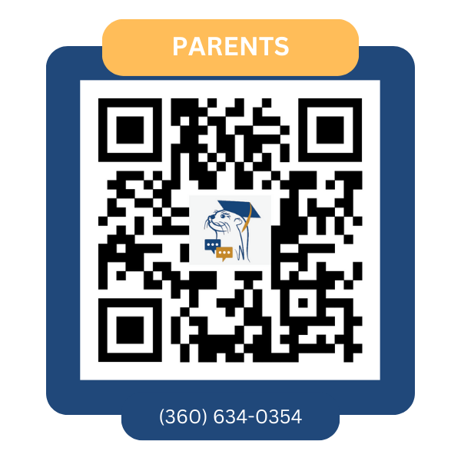
GOT QUESTIONS ABOUT
FINANCIAL AID OR COLLEGE?
If you're not already getting messages, text us using the QR code or the number below:
OtterBot is a free 24/7 texting service for WA HS students and their parents.
Get instant answers on financial aid and college access anytime, anywhere!
Notes:
If you’re not already getting messages:
Students: Text 360-928-7281 and say, “Hi Otter!”.
Parents: Text 360-634-0354 and say, “Hi Otter!”.

Slide 17

High School Students & Parents:
STAY
CONNECTED!
WERE YOU ENROLLED FOR COLLEGE BOUND IN 7TH, 8TH, OR 9TH GRADE?
WE NEED YOUR CURRENT CONTACT INFO! USE THIS QR CODE. IT ONLY TAKES A MINUTE.
Notes:
The Contact Info Form link is also available here: bit.ly/cbcontactstudppt

Slide 18

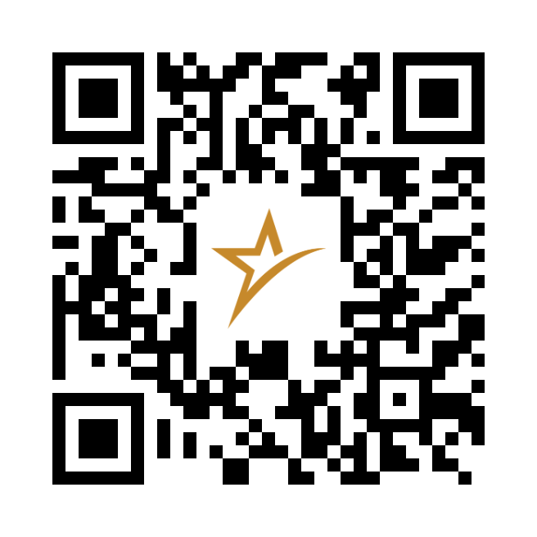
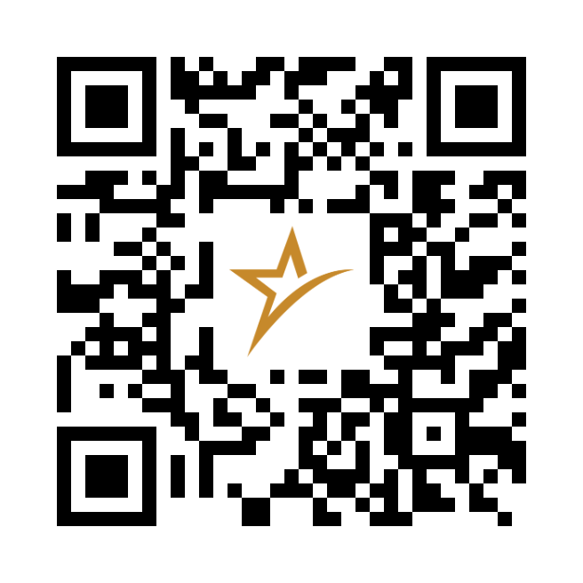
These videos explain what College Bound is, how it can help you, and how to use it to prepare for education or training after high school.
COLLEGE BOUND STUDENT VIDEOS
Learn about College Bound with our Short, Animated Videos
Available in English & Spanish!
bit.ly/cbvideoenglish
bit.ly/cbvideospanish
Notes:
Understand the College Bound Program with our Short, Animated Videos: Available in English (https://www.youtube.com/watch?v=swBinkIhoZA&list=PLJwFzPB3tLoIEtHgZMlFsmpW5Sv1Mr3sR) and Spanish (https://www.youtube.com/watch?v=dVdRFYrval8&list=PLJwFzPB3tLoLQsPRAS7ciMFIA-Ax2ut2v), these videos provide clear, accessible information on College Bound, its benefits, and how to leverage this opportunity for post-high school education or training.
MS & HS staff and college access professionals: Use the Video Learning Outcomes and Discussion Questions (https://wsac.wa.gov/sites/default/files/College%20Bound%20Video%20Learning%20Outcomes.pdf) to actively engage your College Bound students.

Slide 19
CONTACT INFORMATION
Not sure if you’re enrolled?
Check with your counselor!
Phone:
1-888-535-0747
Option 1
Email: collegebound@wsac.wa.gov

