Slide 1



Introduction to Financial Aid

Slide 2

About the Washington Student Achievement Council
We advance educational opportunities and attainment in Washington.
Notes:
https://wsac.wa.gov/
Our mission
We advance educational opportunities and attainment in Washington. In pursuit of our mission, the Washington Student Achievement Council:
Leads statewide strategic planning to improve educational coordination and transitions.
Supports Washingtonians through the administration of financial aid, 529 college savings plans, and support services.
Advocates for the economic, social, and civic benefits of postsecondary education.
Our vision
We inspire and foster excellence in educational attainment.
Our commitment to equity
In support of advancing educational attainment for all Washingtonians, we commit to fostering a culture of equity, diversity, and inclusion among our staff and in all areas of our work.

Slide 3
What Will I Learn Today?
Types of Financial Aid
When You Should Apply for Financial Aid
Scholarships
What is Financial Aid
How to Apply for Financial Aid
Help and Resources

Slide 4
What is Financial Aid?
Financial aid is money to help pay for college or career school. Grants, work-study, loans, and scholarships help make college affordable.

Slide 5

Financial Aid Is An Umbrella
Grants
Scholarships
Loans
Work Study
Income-based, federal, state and institutional.
Merit and income-based, from public, private, and nonprofit sources.
Income-based, federal and private.
Income-based, federal, state and institutional.
Notes:
There is not just one meaning for “financial aid”. These are the fours types: • Grants: income-based, federal and state. • Scholarships: merit and income-based, from public, private, and nonprofit sources. • Loans: income-based, federal and private. • Work Study: income-based, federal and state. We will talk next about the specifics.

Slide 6
Grants
A grant is gift aid that often based on financial need and does not need to be repaid (unless, for example, you withdraw from school and owe a refund).
Washington College Grant
Pell Grant
Notes:
For more information about the Washington College Grant and other state financial aid please go to https://wsac.wa.gov/wcg
For more information about Federal Pell Grants https://studentaid.gov/understand-aid/types/grants/pell

Slide 7

Washington College Grant (WA Grant)
Washington State has made a groundbreaking commitment to
financial aid for low- and middle-income people of all ages with the Washington College Grant (WA Grant). This grant gives eligible people more money for more types of education like certificate programs, job training, apprenticeships, or college.
Notes:
The Washington College Grant (WCG) program—formerly known as the State Need Grant (SNG)—makes education and training beyond high school affordable. WCG provides need-based financial aid to income-eligible students pursuing education after high school. The maximum award amount will cover full tuition at any approved/eligible in-state public college or university, including community or technical colleges, or provide a comparable amount toward tuition and other education-related costs at an approved private college or career training program. For more information go to https://wsac.wa.gov/wcg

Slide 8



Washington College Grant Provides a Unique Opportunity
With the Washington College Grant (WCG), more families are eligible for financial aid than ever before.
Family Size | Full Award | Partial Award
 | Income $38,000 or less | Income Up to $58,500
 | $73,000 or less | Up to $112,500
Award amounts vary based on income, family size, and the school or program attended.
Notes:
Learn more about WCG eligibility and awards at https://wsac.wa.gov/wcg-awards complete MFI chart can be found at https://wsac.wa.gov/sites/default/files/2023-24.WCG.MFIChart.pdf

Slide 9


Scholarships
Scholarships are gifts that don’t have to be repaid and are designed to help students pay for college. They can be a one-time gift or renewable. One of the largest scholarships in WA is the Washington State Opportunity Scholarship.
You can start your scholarship search by going to thewashboard.org
Notes:
https://washboard.wsac.wa.gov/login.aspx
Looking for scholarships? theWashBoard.org makes it simple.
The Washboard connects Washington students of all types with Washington scholarship providers….for FREE.
Whether you’ll be attending in state or out, you save time by entering your profile once and letting us find the scholarship opportunities that fit. theWashBoard.org is spam-free and will never sell your information
How does it work? Scholarship providers build a listing for each scholarship they want to offer on our site. This listing provides all the necessary information for potential applicants. Students-scholarship seekers-create a profile online, which is then compared to all available scholarships. A list of the seeker’s best scholarship matches is immediately displayed to them online. The seeker creates an application for their matches after reading the details provided. Seekers can apply for as many scholarships as they choose. The scholarship seeker submits an application to the provider either by mail, by website, or by using theWashBoard.org as the electronic application host. The provider reviews their applications. If theWashBoard.org serves as the electronic host, the provider can review applications online or download and print. The site can also be used to email applicants about their scholarship status

Slide 10
Work-Study
Work-Study
Tutoring
Fitness Center
Library
Computer Lab
Student Life
Outreach
Work-Study provides part-time jobs for students with financial need, allowing them to earn money to help pay education expenses. These jobs are typically on campus.
Notes:
Work Study is an income-based program provided by both the federal and state. A student must select they are interested in Work Study on their financial aid application in order to be considered for this program.

Slide 11
Loans
A student loan is money you borrow for your education, and pay back over time. Unlike grants or work-study you do have to pay back your loans. You do not have to accept all the loans offered to you.
Interest is paid by while you're enrolled at least half time in college.
Subsidized Student Loans
Unsubsidized Student Loans
Interest begins accruing as soon as the loan is disbursed, including while you are enrolled in school.
Notes:
For more information about federal student loans, go to https://studentaid.gov/understand-aid/types/loans
You can find resources on student loans at our student loan advocacy site at https://wsac.wa.gov/loan-advocacy and https://www.studentloaned.wa.gov/

Slide 12
Sources of Financial Aid
Federal
State
College
Organizations
Typically can be used at most schools in most states.
Typically for residents to attend most colleges in the state.
Offered by a specific school to attend that school.
Offered by non-profits, business, churches, etc.
Notes:
Financial aid can come from several sources: Federal: This is from the US Department of Education and can be used at most colleges in the US. They have to be able to receive financial aid. Students can take to another state. State: For example, Washington state financial aid is for residents to attend colleges in WA. They do not necessarily have to be public colleges, but they have to be able to receive state financial aid. There are currently over 60. College: Every college will have their own scholarships, etc that they offer to students who are going to their school. Organizations: These tend to be scholarships (organizations) or private loans (banks). We will talk about applications for these specific forms of aid later.

Slide 13

Examples of Federal Financial Aid Programs
Pell Grant
Federal Work-Study
Unsubsidized/Subsidized Student Loans
Parent Loans
Notes:
There are several types of federal financial aid. Students need to be U.S. citizens or eligible non-citizens (i.e. permanent residents with a Green Card as an example) to apply. Pell Grant: The largest income-based grant. You may be familiar with this grant as it is a long-standing program. There have been some changes over the years, so make sure you investigate current Pell Grant requirements such as maximum award amounts use during the summer. Work-study: Students can work on campus and their salary is paid from the Dept of Education on-campus employer—>student. Not all on campus jobs require a student to be part of the work-study program. Loans: Both these are in the student’s name. The difference is that with Unsubsidized student loans the student will ultimately pay the interest accrued once they graduate and/or leave college. Subsidized student loans – the government pays, or subsidizes the interest. Parent loans: Would be taken out by the parent to pay for the student’s expenses. There are additional requirements, such as a credit check. There is not limit on the loan amount for parent loans. If offered any/all of these loans from the government, students/families can accept none, partial, or all that they want to utilize. There are also private loans from banks but they typically have higher interest rates and more limited repayment options that federal loans. Students apply for these programs using the Free Application for Federal Student Aid (FAFSA). Students who are not eligible to apply for these programs due to immigration status would not be eligible for these programs, such as federal student loans.

Slide 14


Examples of State Financial Aid
Washington College Grant (also known as the WA Grant)
College Bound Scholarship
State Work-Study
Passport to Careers
Opportunity Grant
Notes:
Learn more about Washington’s state financial aid programs, collectively known as opportunity pathways go to https://wsac.wa.gov/sfa-overview
These are examples of state financial aid programs that WA residents who are eligible can use in WA at eligible colleges – you may see them referred to as Washington Opportunity Pathways. Washington College Grant (formerly the State Need Grant) largest, income based grant. The amount depends on what type of school (out of the over 60) you attend. College Bound Scholarship: This is an early commitment of state financial aid to cover certain college costs. Students must have signed up in middle school. We’ll talk more later. State Work-Study: Similar to the federal program but the funding comes from Washington State versus the federal government. Passport to Careers: program that provides additional resources for both former foster youth and unaccompanied homeless youth (https://www.wsac.wa.gov/sites/default/files/Passport.Student.FAQs.pdf) Opportunity Grant: to attend a 2 year community or technical college 5 Students who can complete the FAFSA (U.S. citizens and permanent residents) are also applying for state aid programs when the complete the FAFSA. Undocumented students who meet program and state residency requirements can apply using the Washington Application for State Financial Aid (WASFA).

Slide 15
College Bound Scholarship
Eligibility and Auto-Enrollment: A Two-Step Process
Step One
Auto-enrollment for eligible public-school students.
Step Two
Meet income and residency requirements.
Fulfill the College Bound Pledge.
Foster Youth are auto-enrolled through HS graduation.
Eligible for FRPL in 7th, 8th, or newly eligible in 9th grade.
Be accepted to and attend an eligible college.
Notes:
www.collegebound.wa.gov
Here are some resources that can help you with supporting your College Bound Scholarship students.
Eligibility is a two-step, book end process.
Step 1:
Students at public schools eligible for free-and-reduced price lunch in 7th, 8th or newly eligible in 9th grade are auto-enrolled. Foster youth in state care are auto-enrolled at any time beginning in 7th grade until they graduate high school. Home schooled and students attending private school should contact the College Bound office to apply.
Step 2:
Students must graduate from a WA HS. If attending a four year college, graduate with a 2.0 GPA or better . They must meet the income requirements, and this is determined by applying for financial aid with the FAFSA/WASFA beginning in their senior year.
Students must attend an eligible WA school within one year of graduating high school to receive funds.

Slide 16

College Bound Scholarship Commitment
Combines with other state financial aid to cover the average cost of tuition (at comparable public college rates), some fees, and a small book allowance = commitment.
Can be used at over 65 two- and four-year public and private colleges and universities.
collegebound@wsac.wa.gov or 888-535-0747, option 1
Notes:
The College Bound Scholarship program is an early commitment of state financial aid to eligible students who are auto-enrolled in 7th,8th or 9th grade (who become newly eligible) and fulfill the College Bound Pledge.
It is a commitment that certain costs will be covered by state financial aid: tuition (at public rates), some fees and a small book allowance. These costs will be covered by state aid and it may come in different buckets, such as the Washington College Grant.
It can be used at programs at over 65 colleges and universitates, technical schools, etc around WA.

Slide 17
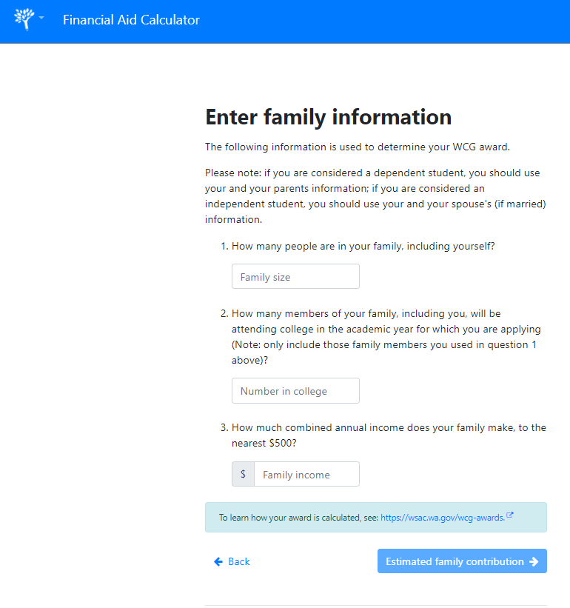
State Financial Aid Calculator
This tool calculates potential awards from the Washington College Grant and Pell Grant programs.
There may be more aid available to you from other state and federal programs, private scholarships, or directly from the college you attend.
The only way to know for sure how much financial aid you can receive is to complete a FAFSA or WASFA financial aid application
portal.wsac.wa.gov/a/aid-calculator
Notes:
https://portal.wsac.wa.gov/a/aid-calculator/ This tool calculates potential awards from the Washington College Grant and Pell Grant programs.

Slide 18
FAFSA/WASFA: Rule of One
FAFSA
Free Application for Federal Student Aid
FAFSA.gov
WASFA
Washington Application for State Financial Aid
wsac.wa.gov/WASFA
OR
Notes:
Speaking of FAFSA and WASFA… Students should only complete one application. Fill out the FAFSA if you are eligible for federal aid (i.e. US citizen/permanent resident) and this will also be used to determine state aid eligibility If you are ineligible for federal aid due to immigration status but you are eligible for a state financial aid program (i.e. for undocumented students) complete the WASFA. Some colleges may also use WASFA in replace of a FAFSA when calculating institutional aid There are resources to help you complete these applications and determine which one to file at https://wsac.wa.gov/WASFA
Note to presenter: You should not ask students which application they should file or their status. Let them self-identify.

Slide 19
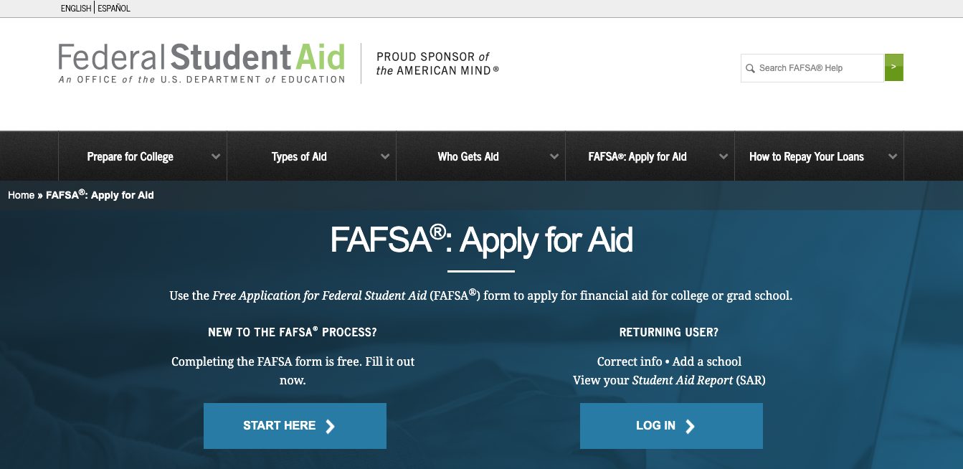
Free Application for Federal Student Aid (FAFSA)
Notes:
Here you can see the Free Application for Federal Student Aid (FAFSA) home page https://studentaid.gov/h/apply-for-aid/fafsa

Slide 20
Two Ways to Apply for the FAFSA
Website
Paper FAFSA
Notes:
Students can use these ways to apply for the FAFSA. The website is the quickest way to apply but students can use the paper application if they are unable to access the application online.

Slide 21
FAFSA Website Language Options
English
Español
Notes:
The FAFSA site is offered in English and Spanish.

Slide 22
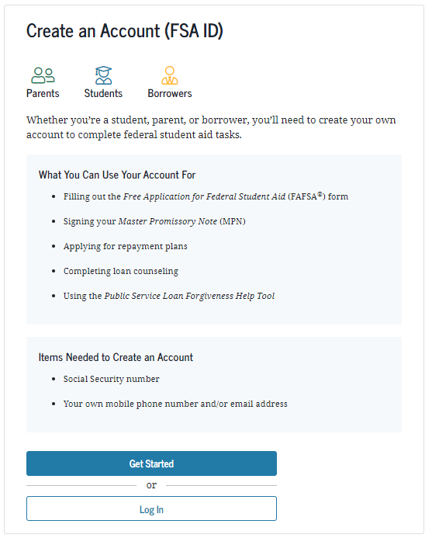
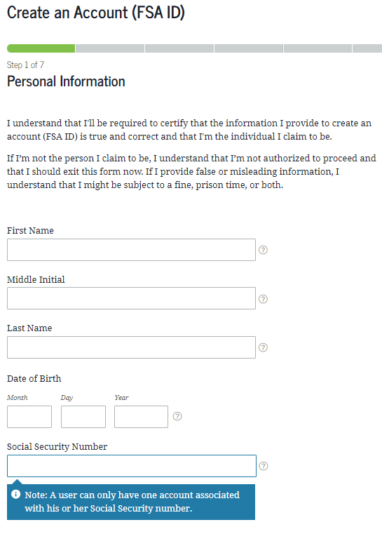
FSA ID – The First Step to the FAFSA
Social Security Number
Their own mobile phone number and/or email address
Notes:
https://studentaid.gov/fsa-id/create-account/launch
If the filer uses the SSN, DOB and Name to access the FAFSA, they will be asked to enter the FSA ID to use the IRS data retrieval tool and to sign and submit the FAFSA.

Slide 23
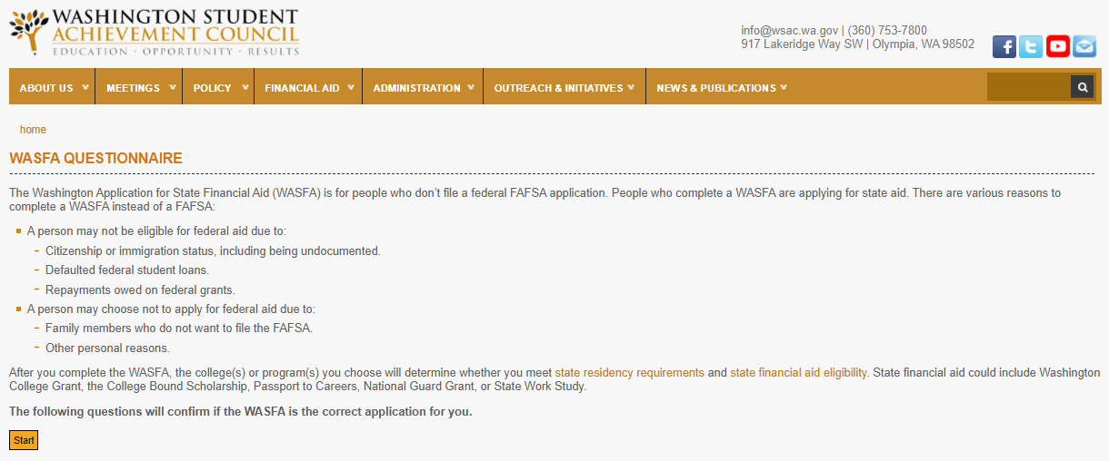
Washington Application for State Financial Aid (WASFA)
https://wsac.wa.gov/WASFA
Notes:
Here is the Washington Application for State Financial Aid (WASFA) application site https://wsac.wa.gov/wasfa

Slide 24
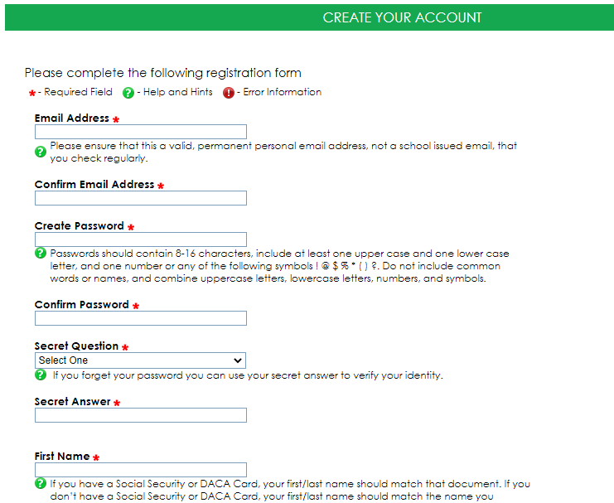
WASFA Account Creation – The First Step to the WASFA
You will need your own email address
The WASFA is available in English and Spanish
You will need internet access
Notes:
Creating a Washington Application for State Financial Aid (WASFA) account is the first step to applying. Students can create their account by going to https://wsac.wa.gov/wasfa

Slide 25
Is a Student Dependent or Independent*
Dependent Student
Requires Parent Information
Independent Student
Does Not Require Parent Information
A student who does not meet any of the criteria for an independent student
*for financial aid purposes
An independent student is one of the following:
at least 24 years old
married
a graduate or professional student
a veteran
a member of the armed forces
an orphan
a ward of the court
someone with legal dependents other than a spouse
an emancipated minor
someone who is homeless or at risk of becoming homeless and self supporting
Notes:
These are the criteria for independent student status. If students do not meet the requirements listed in right column they most likely will be considered a dependent student for financial aid.

Slide 26
What Do I Need to Apply for Financial Aid
Your driver’s license or state ID. (If you have one)
Your income information
Your parent most likely will need to provide information, if you are 24 or younger.
FAFSA Filers Should Also Have Access to:
Your Social Security Card or green card.
Parent’s Social Security Number (if they have one).
This includes bank statements, a W-2 or pay stub, and a 2022 tax return if applicable.
This includes bank statements, child support statements, W-2 or pay stubs, and a 2022 tax return if applicable.
Your FSA ID and your parent(s) will also need to create an FSA ID.
Notes:
Here us a list of the documents students will need to apply for financial aid.

Slide 27
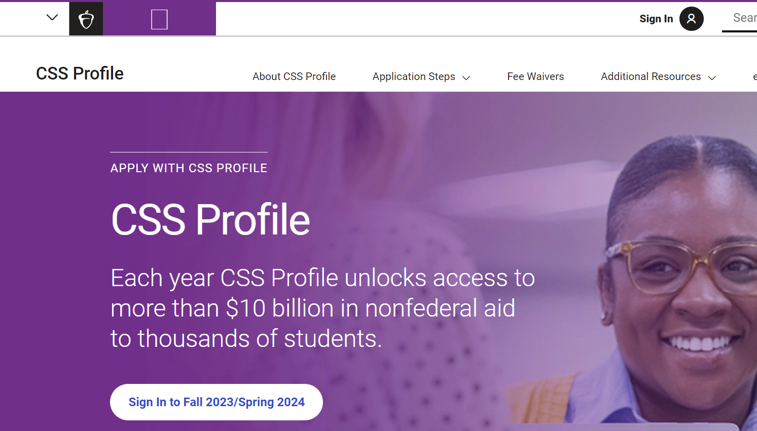
CSS Profile
Additional profile that some colleges use to award institutional aid.
The CSS Profile is free for domestic undergraduate students whose family income is up to $100,000. The fee for the initial application is $25. Additional reports are $16.
https://cssprofile.collegeboard.org/
Notes:
Additional profile that some colleges use to award institutional aid.
The CSS Profile is free for domestic college students whose household income is up to $100,000. The initial application fee is $25. Additional reports are $16.

Slide 28
Financial Aid Timeline
FAFSA & WASFA open in December
Students apply for financial aid and admissions
Create an FSA ID or WASFA account (only created once)
Gather required documents
Follow up with colleges for any additional request for information
Review your award letters and accept your aid.
Notes:
This is the financial aid timeline. Some of these steps can be taken at the same time.

Slide 29



Important Information for the Class of 2024
The 2024-25 FAFSA & WASFA will be available in December
2025-26 and beyond will be available in October
Class of 2024 will complete the 2024-25 FAFSA or WASFA using 2022 income information
OR WASFA
Notes:
This year the 2024-25 FAFSA & WASFA will be available in December. The actual release date will be provided by Federal Student Aid. This will impact the class of 2024 when they apply for the 2024-25 FAFSA or WASFA. For 2025-26 and beyond FAFSA & WASFA will be available in October.

Slide 30
Class of 2024 Next Steps
Explore Your Options
Determine Which Financial Aid Application To Use
If you are not sure which application to complete go to https://wsac.wa.gov/WASFAelig
Create an FSA ID or WASFA Account
You can create an FSA ID by going to https://fsaid.ed.gov/npas/index.htm
Explore your post secondary options using your high school and beyond plan.
You can create a WASFA account by going to https://wsac.wa.gov/WASFAelig
Talk to your counselor to make sure you are on track for graduation.
Complete your 2024-25 application starting December 2023
Notes:
Here are the next steps for the class of 2024

Slide 31
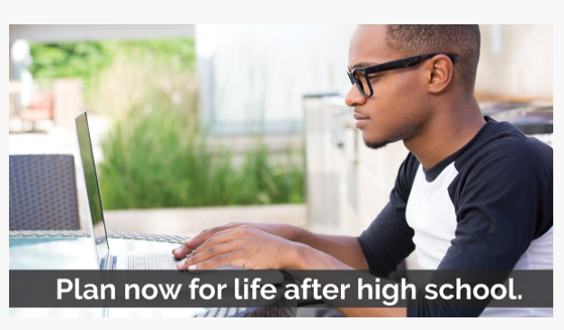
Resource: www.wsac.wa.gov/actionplan
One-stop site for juniors and seniors
Career exploration resources to application information
Notes:
Students can find more information about education after high school at our action plan page.

Slide 32

Resource: 12th Year Campaign Resources and Events
Free virtual financial aid completion events to help you take the next step!
Free resources that support you with financial aid, college admissions and more.
https://wsac.wa.gov/actionplan
Notes:
This comprehensive workbook will assist your juniors and seniors with identifying their postsecondary plan goals with useful activities as well as provides critical information around admission and financial aid programs.
The 12th Year Campaign workbook can be found at https://gearup.wa.gov/sites/default/files/resources/2023%20Final%20Edit-12th%20Yr%20Workbook-Fillable%20PDF.pdf

Slide 33
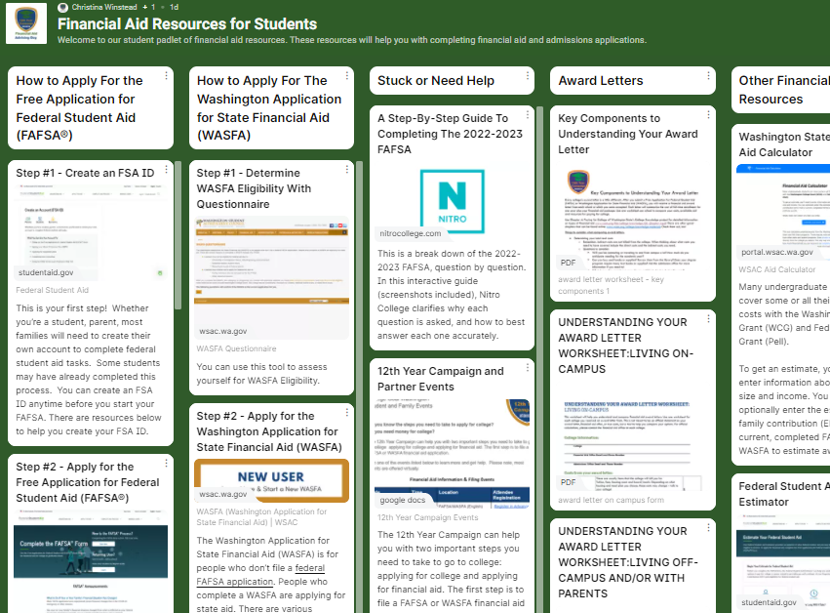
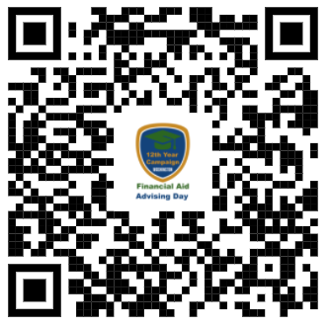
Resource: Financial Aid Padlet For Students
https://padlet.com/christinaw12/t6jfitu7m8in10xc
Notes:
Padlets are digital information boards. This student padlet has information to support them as they explore education after high school. This padlet also includes all the links to financial aid applications and where they can find support applying.

Slide 34
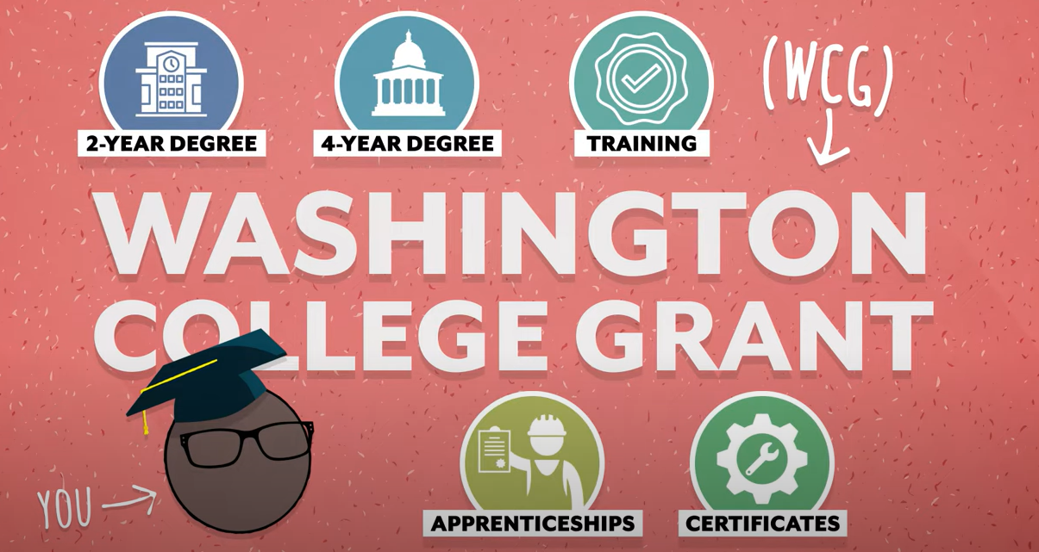
Washington Financial Aid for Education and Training Videos
Informational videos about education after high school in the following languages:
•English
•Mandarin
•Russian
•Somali
•Spanish
•Tagalog
•Vietnamese
Notes:
Washington Financial Aid for Education and Training Videos
Informational videos about education after high school in the following languages:
•English
•Mandarin
•Russian
•Somali
•Spanish
•Tagalog
•Vietnamese

Slide 35
We Are Here to Help!
Online:
wsac.wa.gov
www.thewashboard.org
wastate529.wa.gov
On Twitter:
@WSACouncil
On Facebook:
www.facebook.com/WSACouncil

Slide 36

Questions

